Slide 1
INDIAN FINANCIAL SYSTEM
P
Presented by:
Presented by:
Syed Idrees Ahmad
Assistant Professor Commerce

Slide 2
Financial System An institutional framework existing in a country to
enable financial transactions
The Indian financial system can be broadly classified into formal (organized) financial system and the informal (unorganised)
financial system. The informal financial system consists
of individual money lenders, groups of persons
operating as funds or associations, partnership firms
consisting of local brokers, pawn brokers

Slide 3
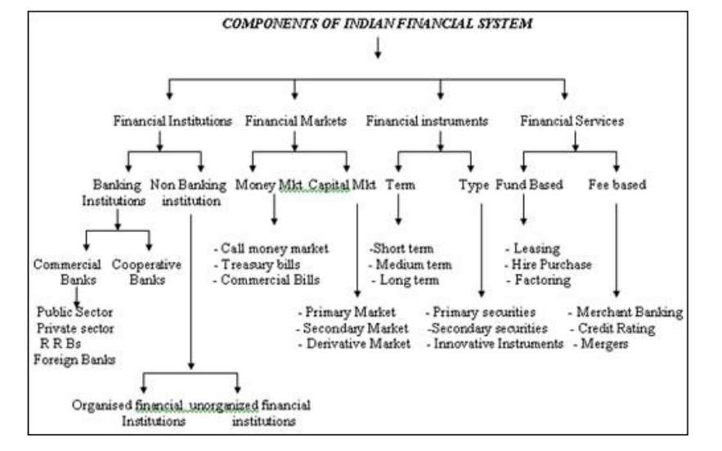

Slide 4
FINANCIAL INSTITUTIONS
Financial institutions are the participants in a financial
market. They are business organizations dealing in
financial resources. They collect resources by
accepting deposits from individuals and institutions
and lend them to trade, industry and others. They buy
and sell financial instruments.

Slide 5
Financial institutions classified as:-
a) Regulatory financial institutions :
The two major Regulatory Institutions in India are Reserve Bank of India (RBI) and Securities Exchange Board of India (SEBI).
All financial institutions are under the control of RBI .
The financial markets are under the control of SEBI.
IRDA regulates insurance sector.

Slide 6
b) Banking institutions :-
Banking institutions mobilize the savings of the people.
They provide a mechanism for the smooth exchange of goods and services.
Basic categories of banking institutions are commercial banks, co-operative banks, developmental banks.

Slide 7
c) Non banking financial institutions:-
Nonbanking financial institutions also mobilize financial
resources directly or indirectly from the people.
They lend funds but not create credit
Companies like LIC, GIC, UTI, Development Financial
Institutions(such as IDBI,NABARD), Organisation of Funds etc. fall in this category.

Slide 8
FINANCIAL MARKETS:-
Financial market deals in financial securities (or financial instruments) and financial services.
Financial markets are the centers or arrangements that provide facilities for buying and selling of financial claims and services.
Financial markets exist wherever financial transactions take place.
Financial transactions include issue of equity stock by a
company, purchase of bonds in the secondary market, deposit of money in a bank account, transfer of funds from a current account to a savings account etc.

Slide 9
Financial market can be classified in 2 on basis of maturity of claims
Money Market: A market where short term funds are borrowed and lend is called money market. It deals in short term monetary assets with a maturity period of one year or less. Liquid funds as well as highly liquid securities are traded in the money market. Examples of money market are Treasury bill market, call money market, commercial bill market etc.
Capital Market: Capital market is the market for long term funds. This market deals in the long term claims, securities and stocks with a maturity period of more than one year. The stock market, the government bond market and derivatives market are examples of capital market.

Slide 10
Financial market can be classified in 2 on basis of seasoning of claim
Primary Market: Primary markets deal in the new securities. Therefore, they are also known as new issue markets. These are markets where securities are issued for the first time. In other words, these are the markets for the securities issued directly by the companies.
Secondary Market: Secondary markets deal in existing securities. Existing securities are those securities that have already been issued and are already outstanding. Secondary market consists of stock exchanges.

Slide 11
FINANCIAL INSTRUMENTS
Financial instruments are the financial assets, securities and claims. They may be viewed as financial assets and financial liabilities.
Financial assets: Represent claims for the payment of a sum of money sometime in the future (repayment of principal) and/or a periodic payment in the form of interest or dividend.
Financial liabilities: are the counterparts of financial assets. They represent promise to pay some portion of prospective income and wealth to others.

Slide 12
TYPES OF FINANCIAL INSTRUMENTS : The financial instruments may be capital market instruments or money market instruments .
Capital Market Instruments: Financial instruments that are used for raising capital through the capital market. It includes include equity shares, preference shares, debentures and bonds.
Money Market Instruments: Financial instruments that are used for raising and supplying money in a short period not exceeding one year through money market are called money market instruments. It includes treasury bills, call money, short notice money, certificates of deposits, commercial bills etc.

Slide 13
FINANCIAL SERVICES
Financial services refer to services provided by the finance industry.
The finance industry encompasses a broad range of organizations that deal with the management of money.
Among these organizations are banks, credit card companies, insurance companies, consumer finance companies, stock brokerages, investment funds and some government sponsored enterprises.

Slide 14
TYPES OF FINANCIAL SERVICES
Fund or Asset Based Financial Services: The firm raises funds through debt, equity, deposits and the bank invests the funds in securities or lends to those who are in need of capital.
• The following are some of these fund-based services such as:
– Leasing and Hire Purchase
– Housing Finance
– Credit Cards
– Venture Capital
– Factoring
– Forfeiting
– Bill Discounting
– Insurance

Slide 15
Fee Based Services: The services wherein financial institutions operate in specialized fields to earn a substantial
income in the form of fees or dividends orbrokerage on operations.
• The major fee based financial services are as follows:
– Credit Rating
– Mutual Funds
– Asset Securitization
– Stock Broking Services

Slide 16
THANK YOU

